Slide 1

BIKE - SHARING RENTAL PROJECT Under the guidance of Hareesh Sir Project- P384 Group number-4

Slide 2
Group members-
Tejal Singh
Prakash Ravindra Thakur
Virendra Singh Bhati
Rahul Kumar Yadav
Pratik Rathod
Anan Singha Gautam
Prashant Kushwaha

Slide 3
CONTENTS
Business Objective
About Datasets
Libraries Used
Exploratory Data Analysis (Eda)
Data Visualisation
Feature Engineering
Model Building
Deployment
Conclusion

Slide 4
BUSINESS OBJECTIVE
The business objective of a bike rental sharing project is to establish a convenient, sustainable, and profitable transportation solution by efficiently managing bike availability, optimizing pricing strategies, enhancing operational processes, ensuring user satisfaction, and fostering growth through data-driven insights and strategic initiatives, ultimately aiming to reduce carbon emissions, alleviate traffic congestion, and provide accessible mobility options for urban and suburban communities.

Slide 5
ABOUT DATASET
The dataset contains features: dteday, season, yr, mnth, hr, holiday, weekday, workingday, weathersit, temp, atemp, hum, windspeed, casual, registered, cnt.
These features represent different aspects of a bike rental characteristics.

Slide 6
LIBRARIES USED
Pandas: The python library used for working with datasets.
Numpy: Used to perform a wide variety of mathematical operations on arrays.
Seaborn: Used for making statistical graphics in pyhton.
Matplotlib.pyplot: Used for creating static,animated,and interactive visualization.
Scikit-Learn: Also known as sklearn library to implement machine learning models and statistical modelling.
Logistic regression :is a statistical method used for binary classification problems, where the outcome variable is categorical and has two possible classes.

Slide 7
EXPLORATORY DATA ANALYSIS (EDA)
EDA, or Exploratory Data Analysis, is the initial examination of data sets to summarize their main characteristics and detect patterns.
EDA visualizes patterns, characteristics, and variable relationships.
Key Libraries: Numpy, Pandas, Matplotlib, Seaborn.
Conducted a thorough analysis of the dataset, focusing on frequency counts of each column to understand the distribution of values.

Slide 8
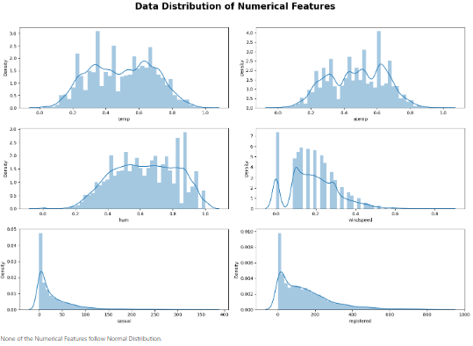
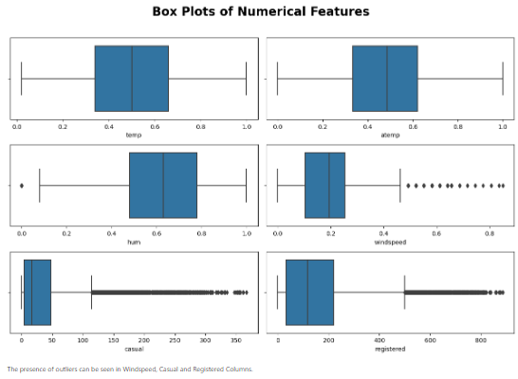
Data Visualization:
Highlighted relationships between numerical features.

Slide 9
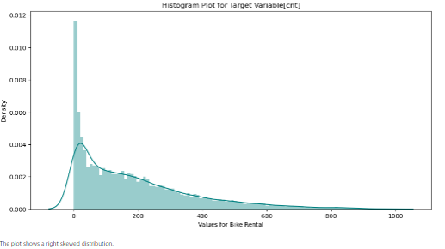
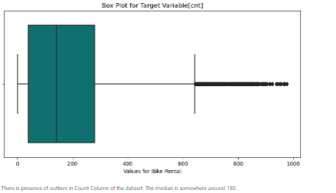

Slide 10
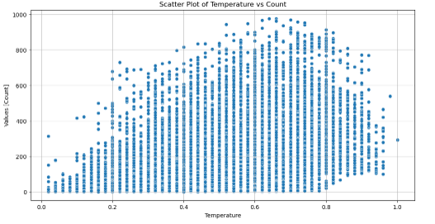
Visualization for Relationship between Numerical Features and Target Variable[cnt]:

Slide 11
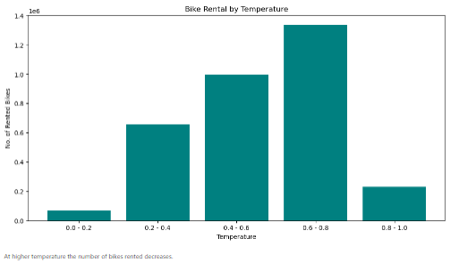
Bike Rental by Temperature

Slide 12
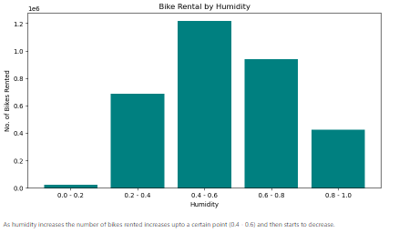
Bike Rental by Humidity

Slide 13
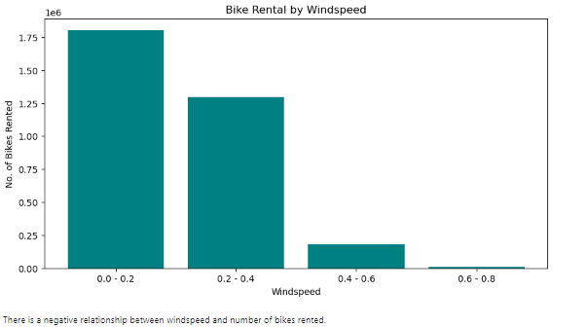
Bike Rental by Windspeed

Slide 14
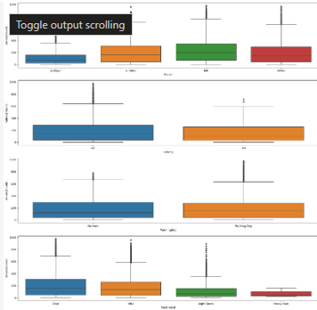
Box Plot for Categorical Columns and Target Variable[cnt]:

Slide 15
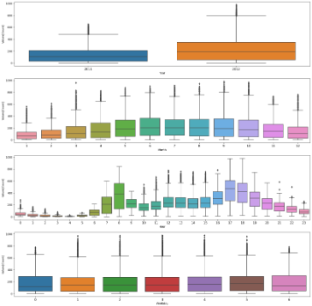
Box Plot for Date Features and Target Variable[cnt]:

Slide 16
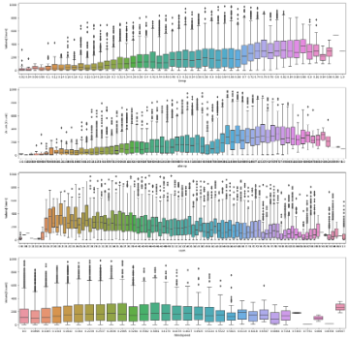
Box Plot for Numerical Features and Target Variable[cnt]:

Slide 17
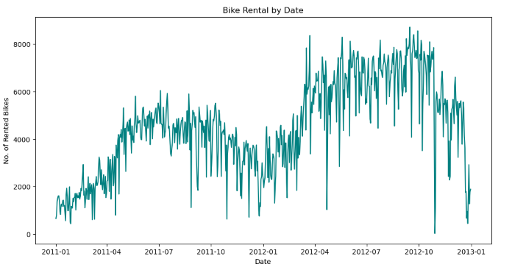
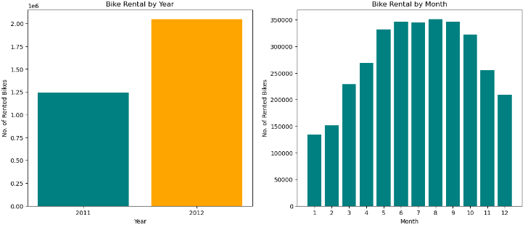

Slide 18
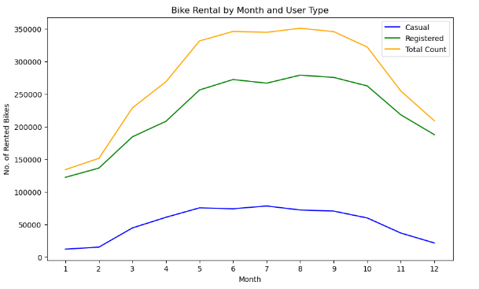
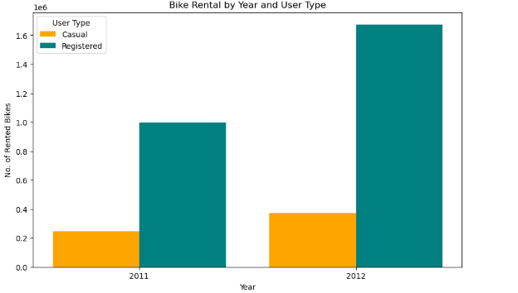

Slide 19
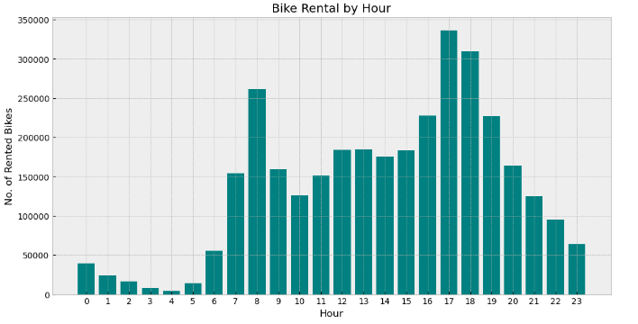
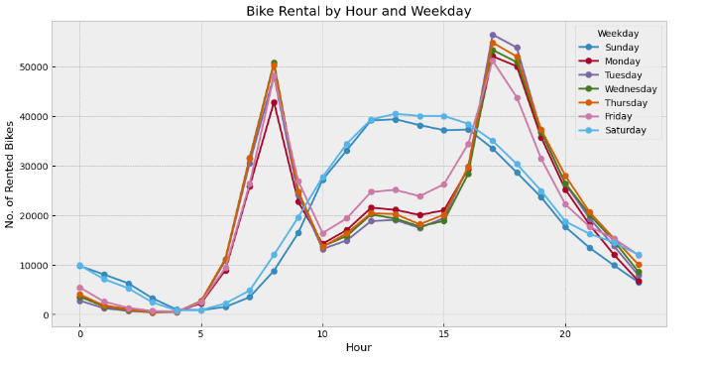

Slide 20
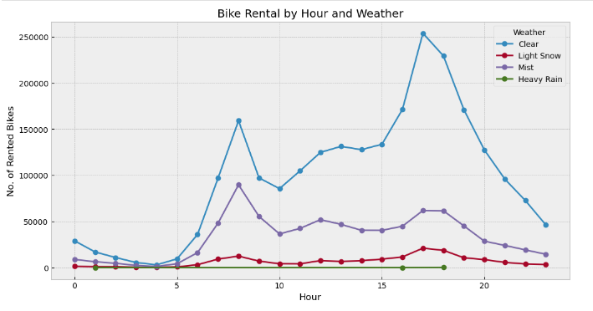
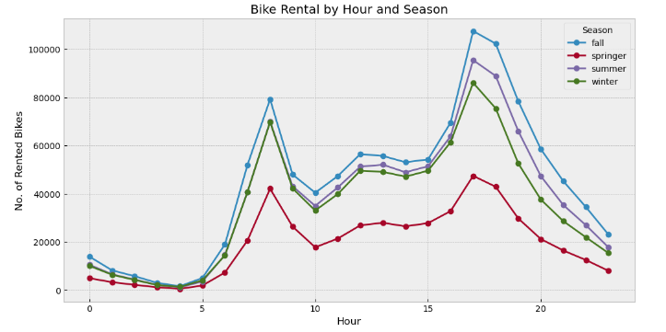

Slide 21
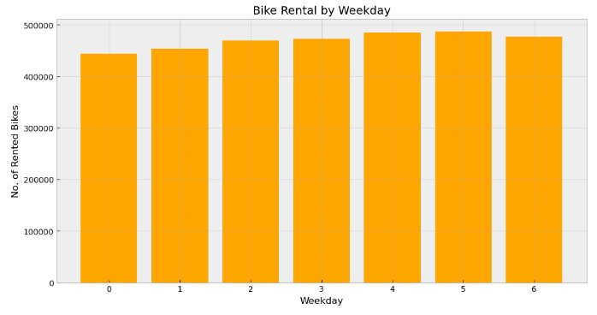
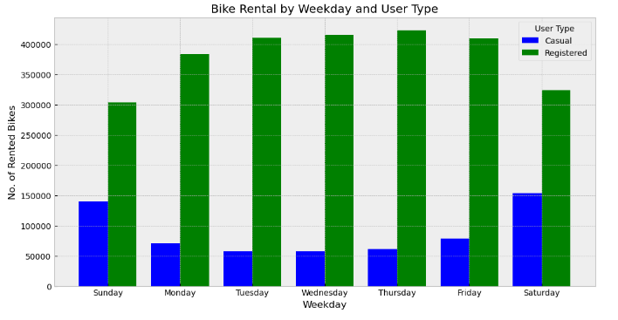

Slide 22
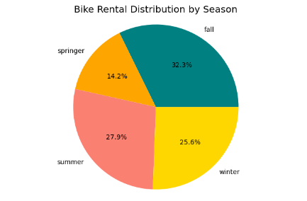
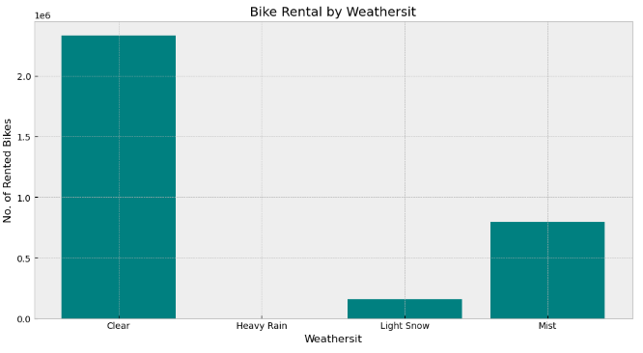

Slide 23
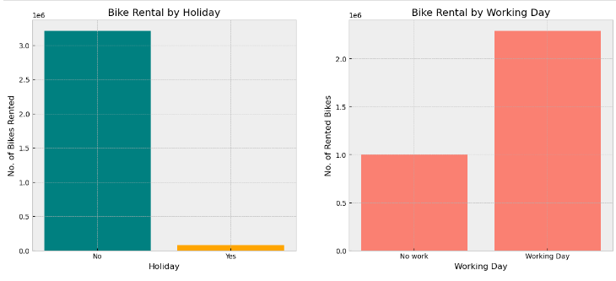

Slide 24
Feature Engineering:
Treating outliers
Encoding Categorical Values
Correlation Coefficient
Normalization of Target Variable

Slide 25
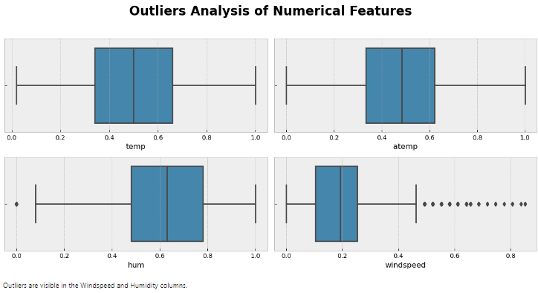
Outliers:

Slide 26
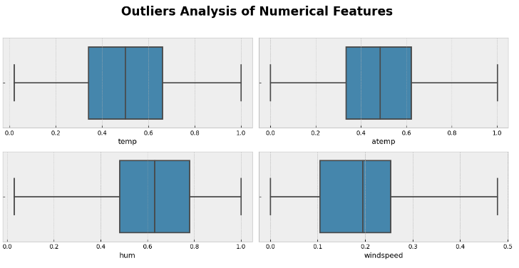
Treating outliers:

Slide 27
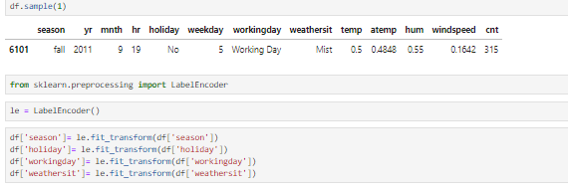
Encoding Categorical Values:

Slide 28
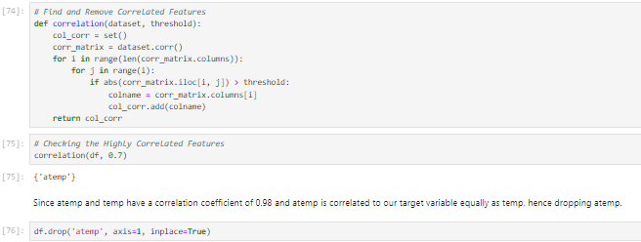
Correlation Coefficient:

Slide 29
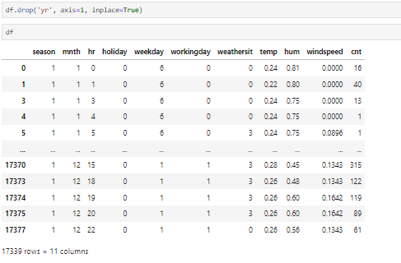
VIF (Variance Inflation Factor):

Slide 30
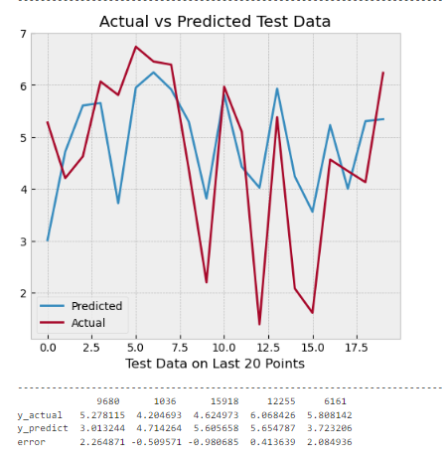
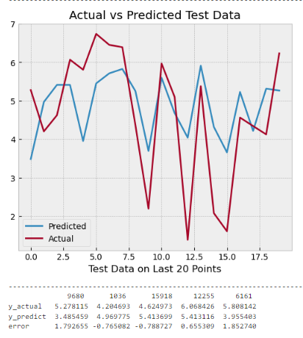
MODEL BUILDING:
Model Construction:
Algorithm:
1. Linear Regression 2. Lasso Regression

Slide 31
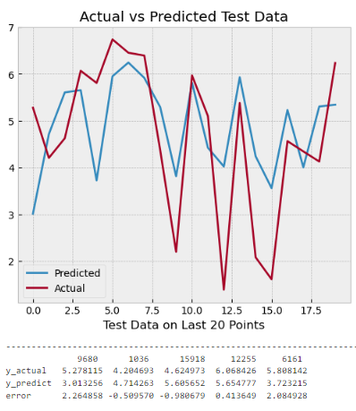
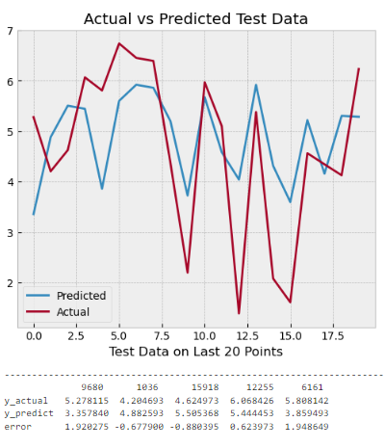
3. Ridge Regression 4.Elastic Regression

Slide 32
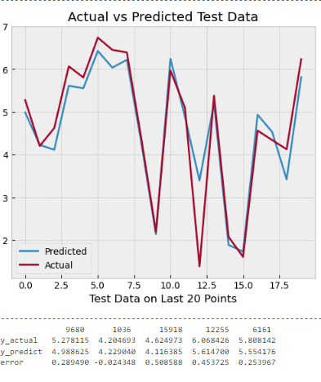
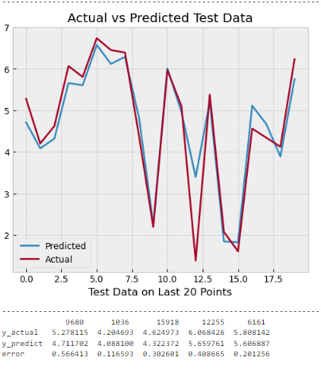
5. Decision Tree 6. Random Forest

Slide 33
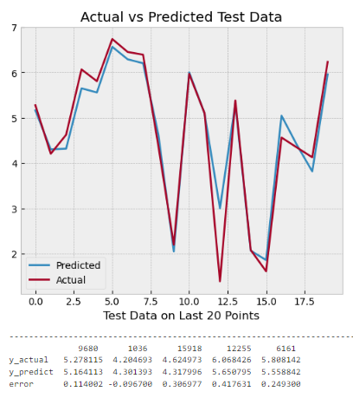
7. Xtreme Gradient Boosting

Slide 34
DEPLOYMENT

Slide 35
Joblib : A Python library that provides tools for efficient parallel computing and data serialization.
Streamlit.io :Streamlit is a free and open-source framework to rapidly build and share beautiful machine learning and data science web apps.
Streamlit : Streamlit is a Python library that simplifies the process of creating interactive web applications for data science and machine learning projects.

Slide 36
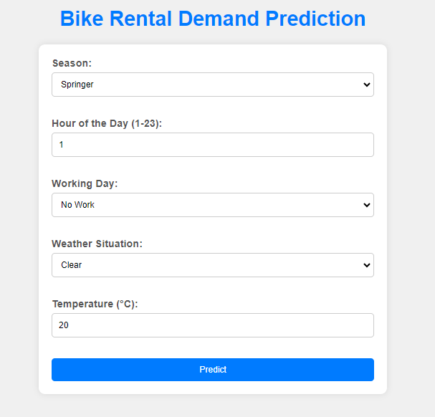
Global Deployment :
Link :

Slide 37
CONCLUSION

Slide 38


